Slide 1

Food Delivery Application

Slide 2
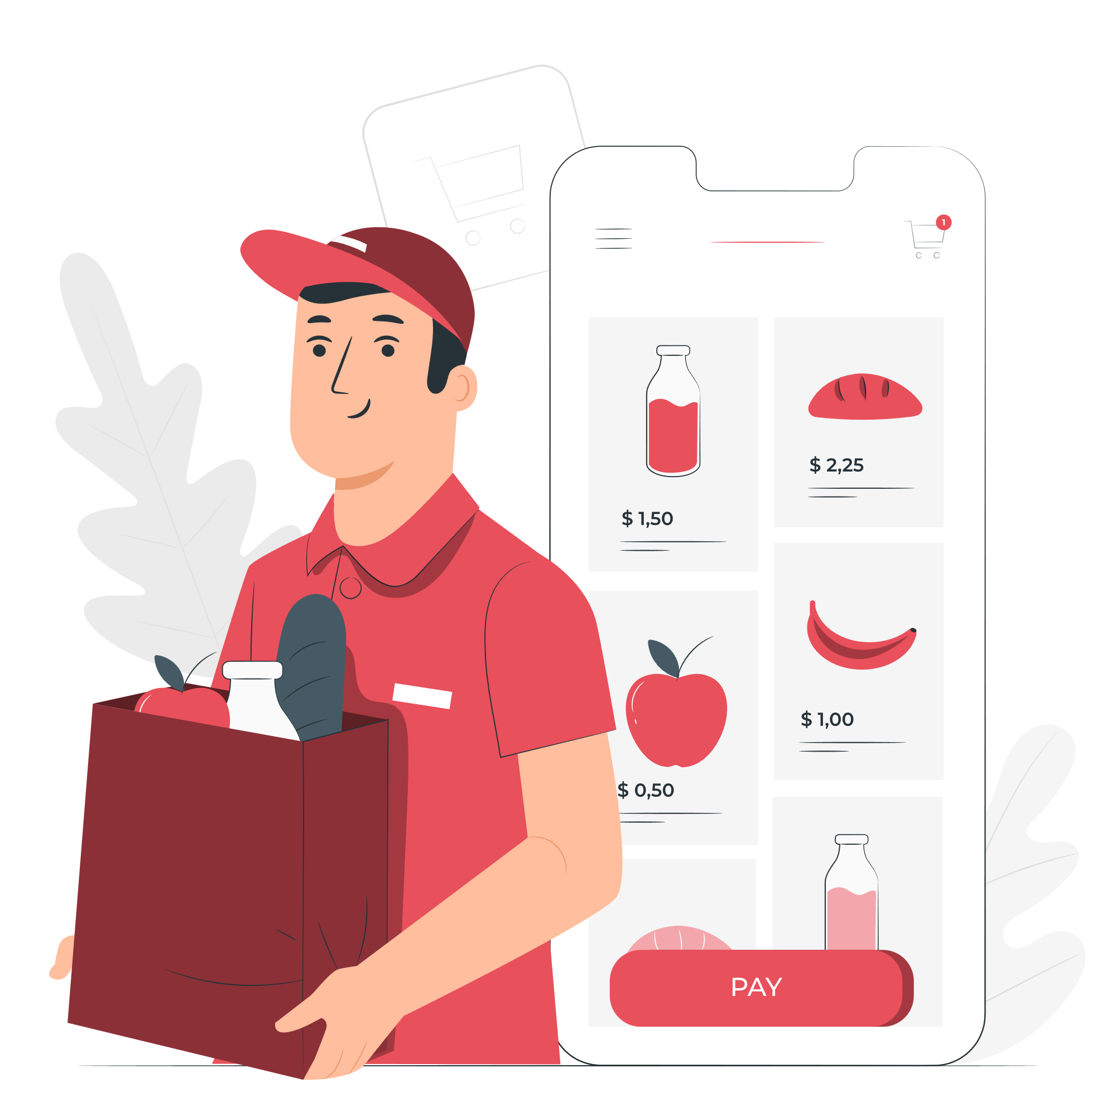
Overview
Delivering Convenience, Multi meal with different locations at a time

Slide 3
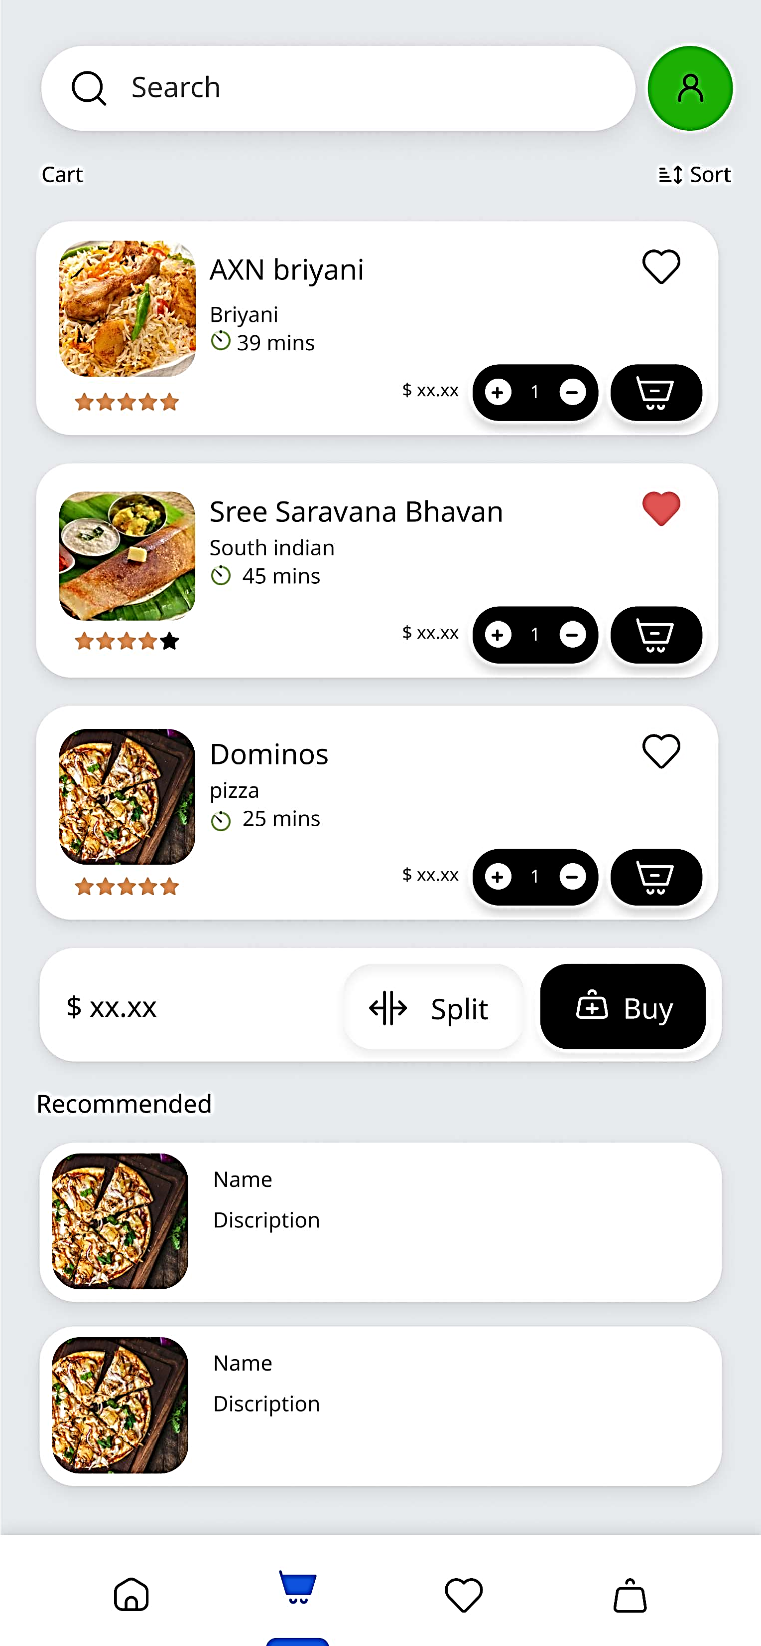
Split Delivery Option
The split delivery option allows users to place orders for multiple locations in single

Slide 4
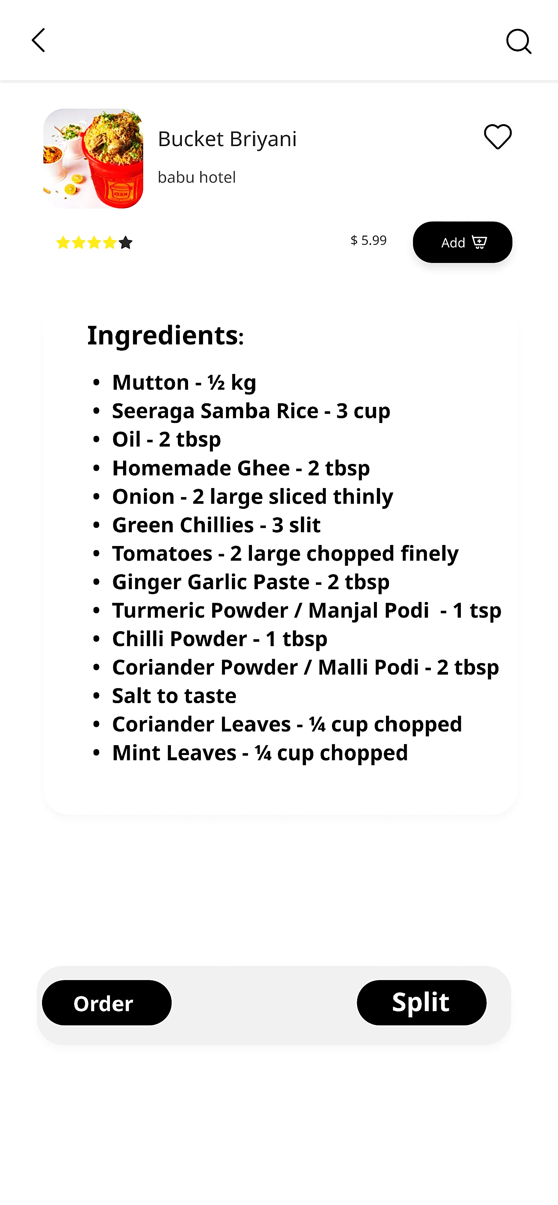
Open Ingredients
Embrace transparency and cater to diverse dietary needs by providing detailed ingredient lists for all menu items, accommodating various dietary restrictions and preferences.

Slide 5

Accessibility
Authentication is streamlined through mobile number verification, ensuring a seamless and secure login process for users.

Slide 6
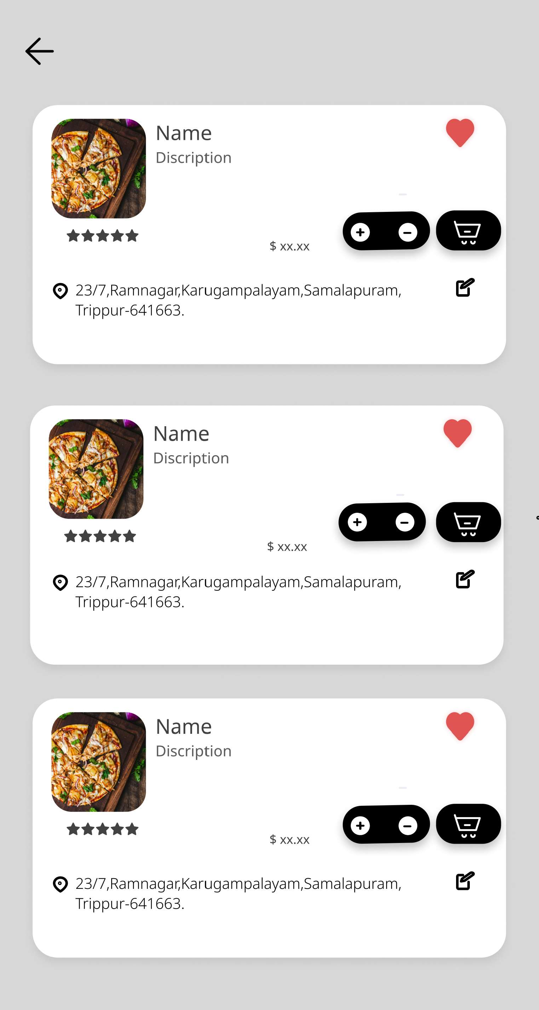
Usability
Simple intuitive navigation and user-friendly interface contribute to a seamless experience for everyone

Slide 7
Conclusion
Our app offers a unique split delivery option, allowing users to deliver to different locations in a single order, catering to diverse needs and scenarios.
We prioritize essential features to ensure accessibility and usability for all users, regardless of technical expertise or familiarity with technology.

